Slide 1


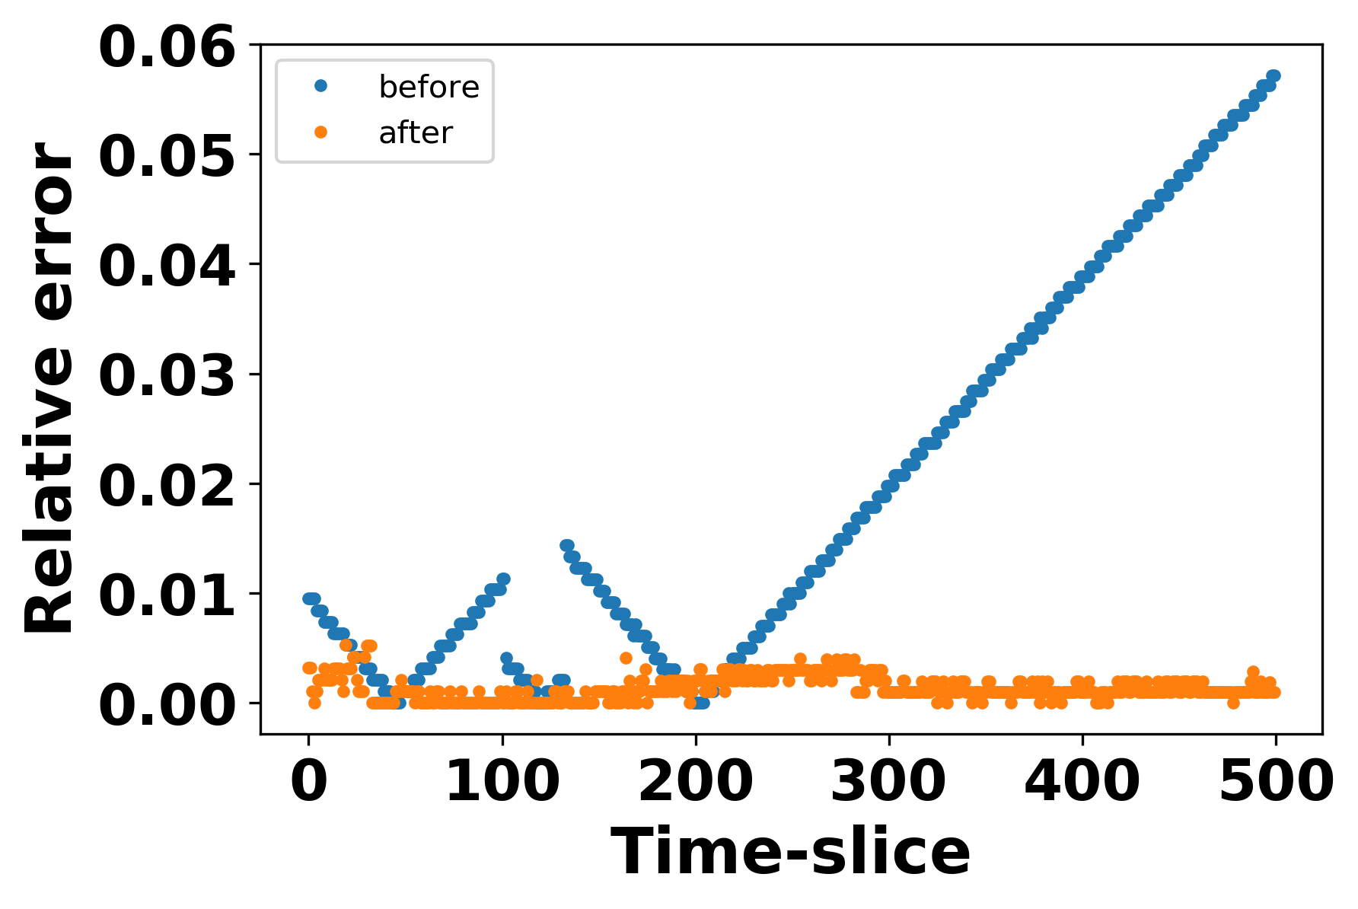
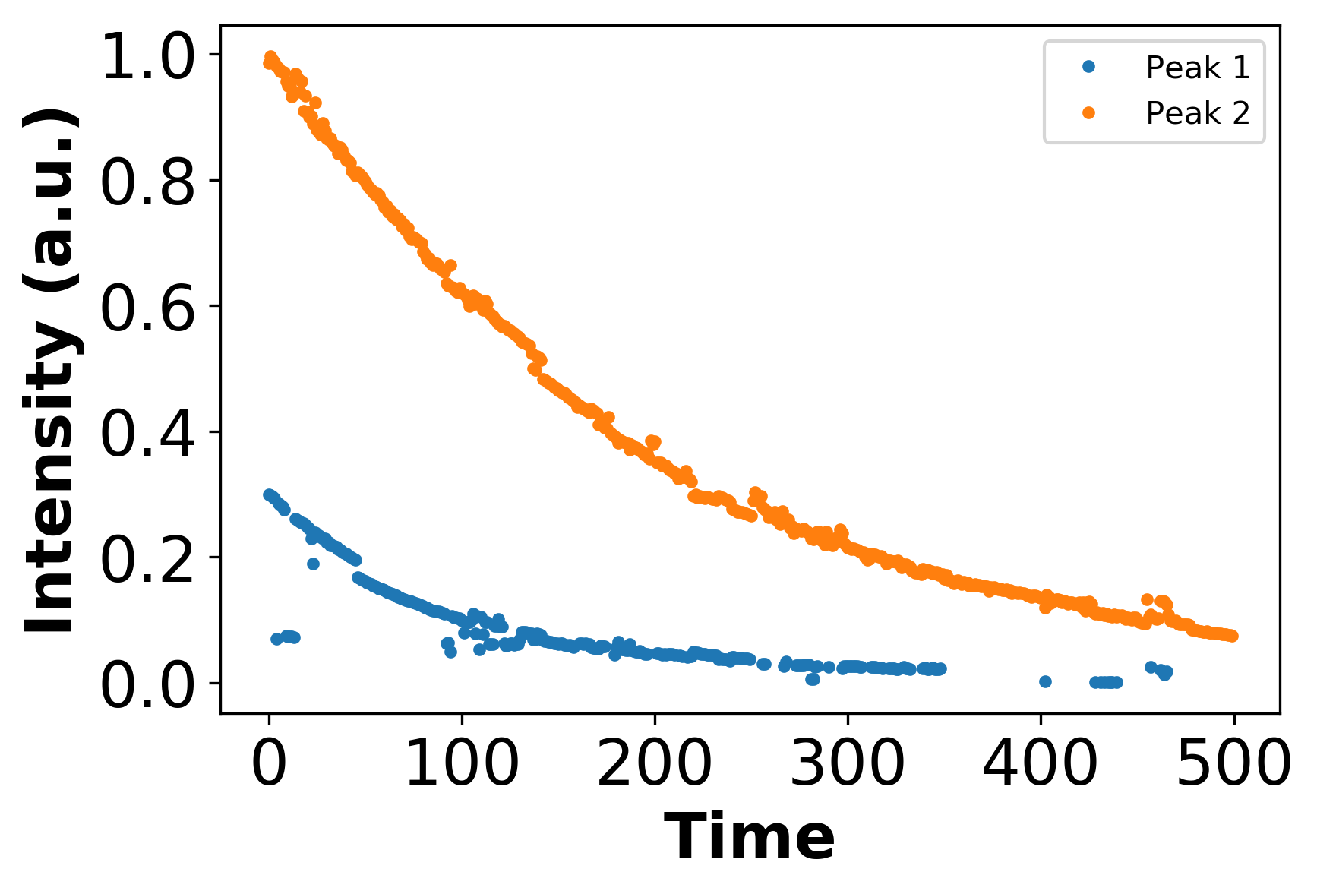
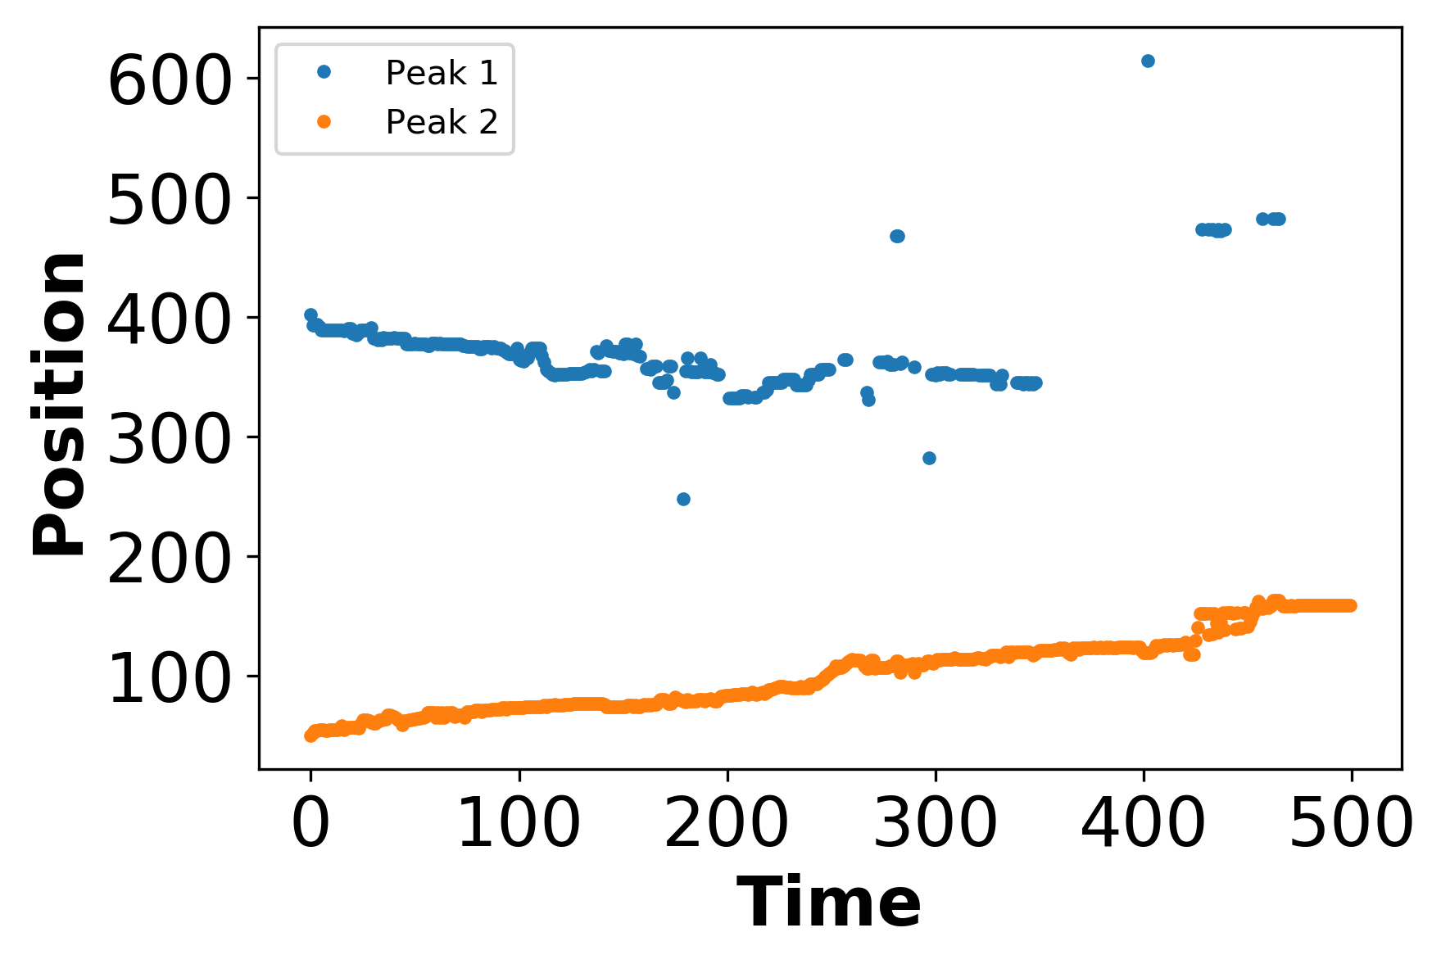
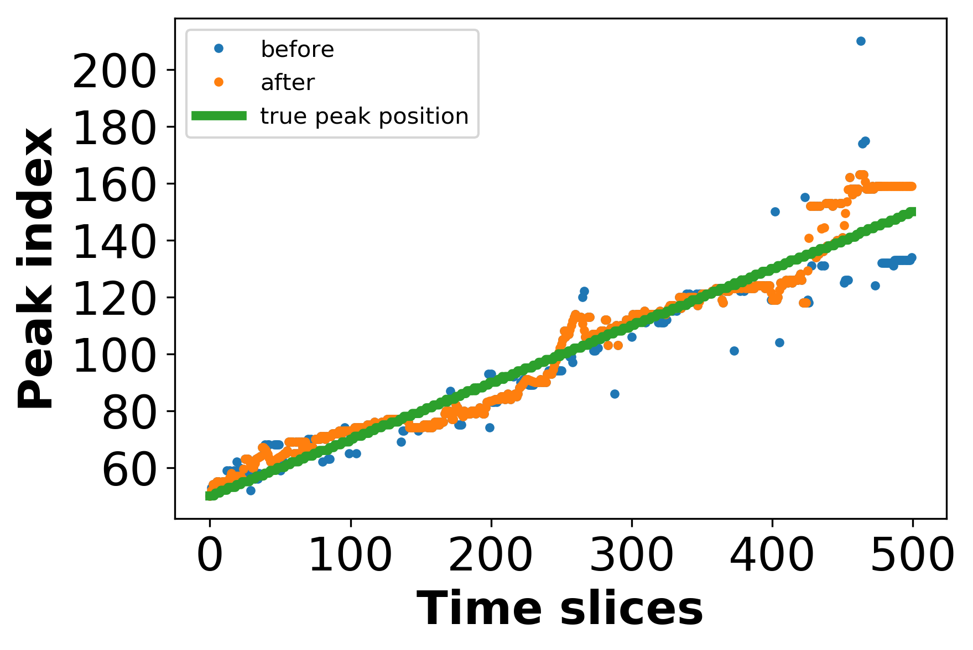
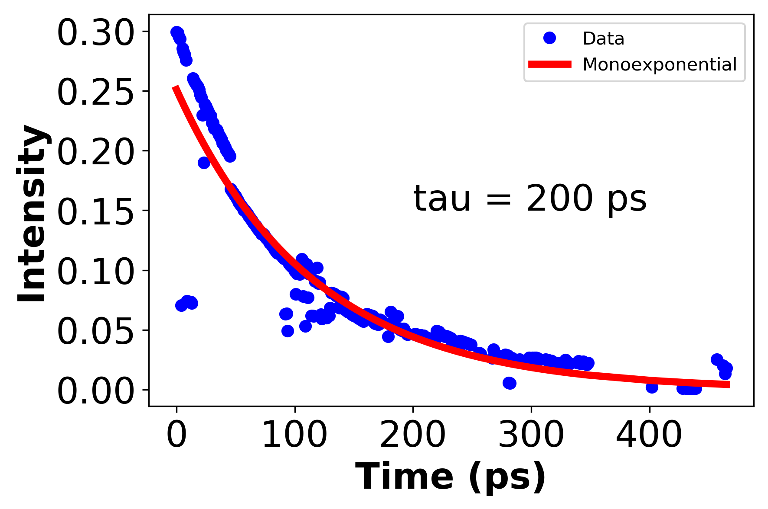
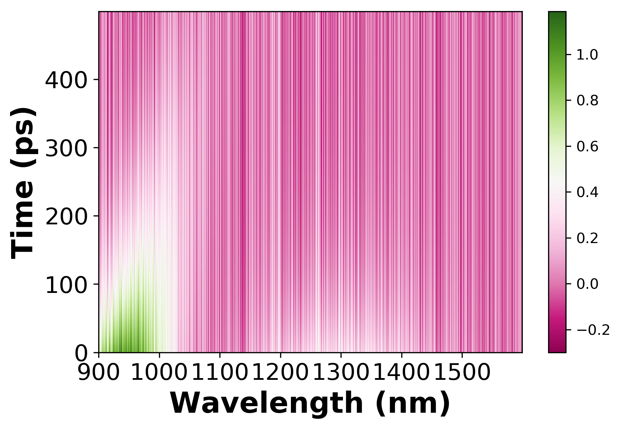
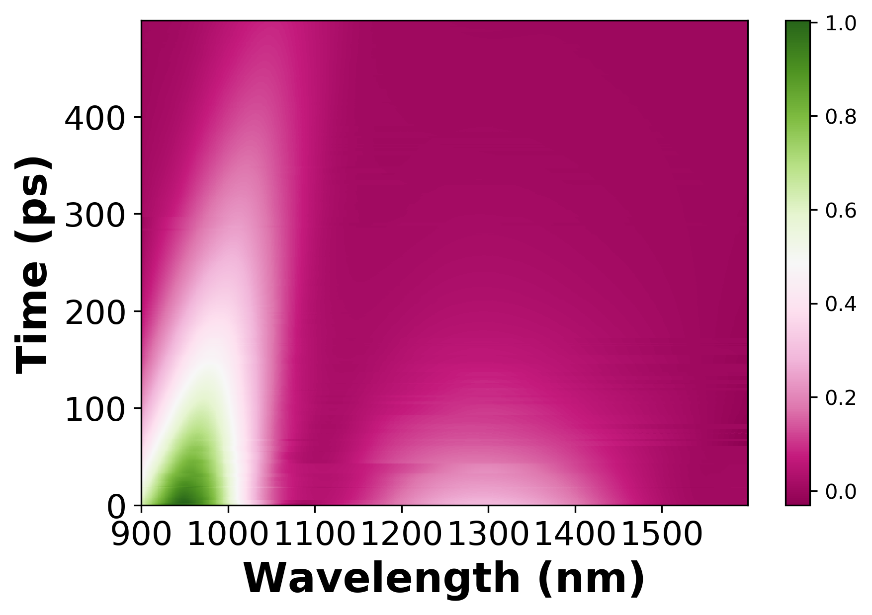
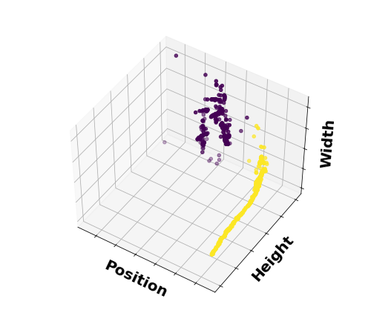
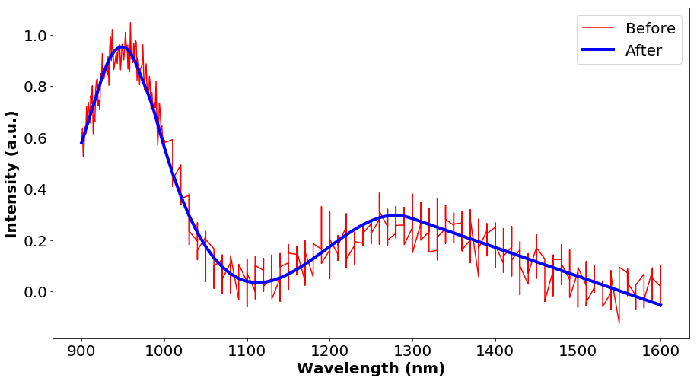

Motivation
Peak Identification, Optimization and Characterization
Peak Dynamics
-identify peaks by finding the local minimum and maximum based on gradient
- Smoothening significantly improves the accuracy in peak identification
- Users can visualize how peak position, height and width change over time
A
-Peak position is optimized by removing outliers and isotonic regression
- We extract kinetic parameters to characterize the dynamics of photoexcited species
Data Smoothening
Peak Classification
-We classify the peaks using K-Means to distinguish neighboring peaks
Future Directions
-Data from user input is smoothened using multivariate adaptive regression splines
- Recover the entire spectrum of individual species with spectral overlap

